Slide 1



Allocation of Public Funds in New York
Data Noobs
American University

Slide 2

Roadmap
Overview
Statistical Modeling
Regression Analysis
Conclusions & Questions

Slide 3


Overview
01
Dataset
03
Description of Variables
02
Analysis
04
Software Used
Database of Economic Incentives from data.gov.
Total State Awards
Program
Industry
Region
Disbursements to Date
Multiple OLS Regression
Power Analysis
Hypothesis Testing

Slide 4
Findings
For every additional dollar invested in small businesses, there is a decrease of $16,050 in agriculture
For every dollar allocated in minority/women related programs, there is an increase of $16,000 in agriculture

Slide 5
Regression Outputs
 | Normalized | Non Normalized | Southwest Region
Observations | 44,460 | 44,460 | 4,080
R2 | 0.37 | 0.02 | 0.45
Adjusted R2 | 0.37 | 0.02 | 0.45
Residual Std. Error | 1.04 | 4.77 | 1.24
F Statistic | 1,429.52 | 49.69 | 214.93

Slide 6
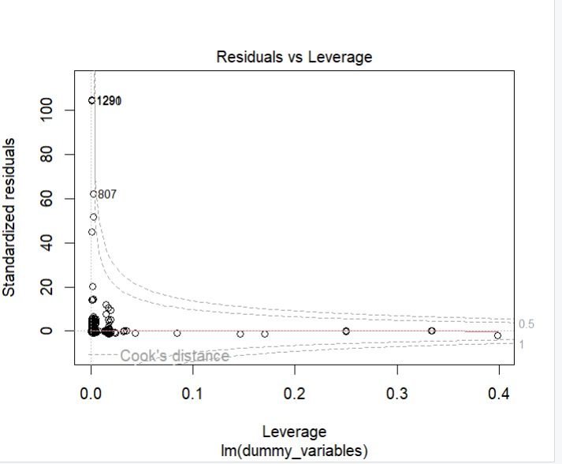
Residual vs. Leverage
No influential outliers in the model

Slide 7
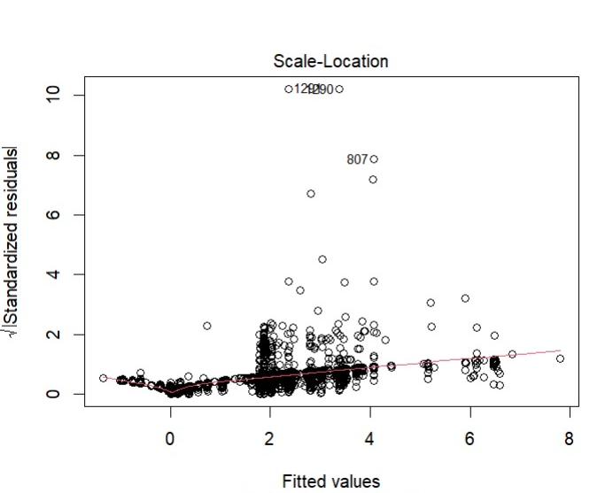
Scale – Location
Residuals are spread closely near the red line
Assumption of equal variance is good as the horizontal line has equally spread points

Slide 8
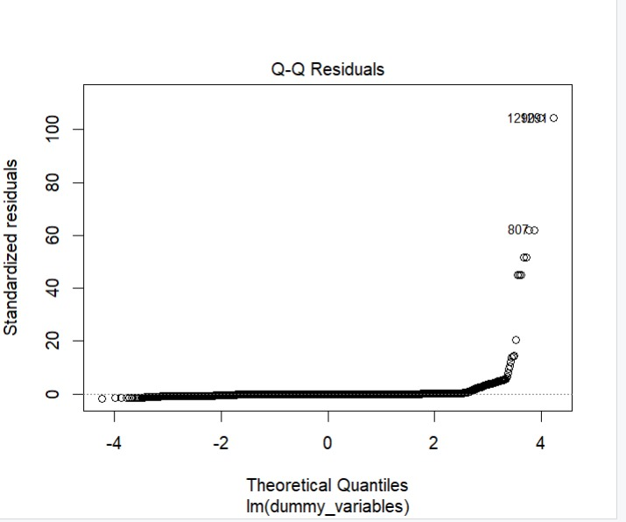
Q - Q Residual
Residuals are normally distributed

Slide 9
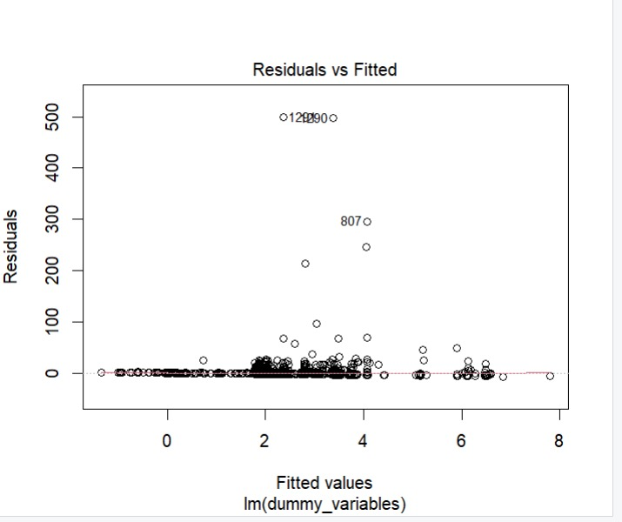
Residuals vs. Fitted
The red line is close to the dashed line
As we move to the right on the x-axis, the spread of the residuals seems to be increasing

Slide 10
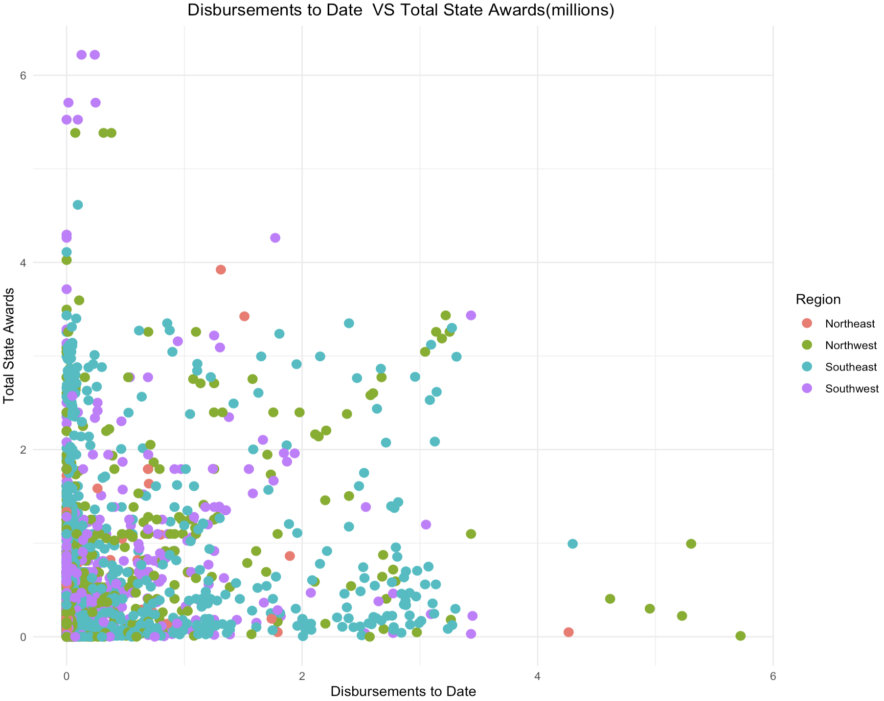
Disbursements to Date vs. Total State Awards

Slide 11
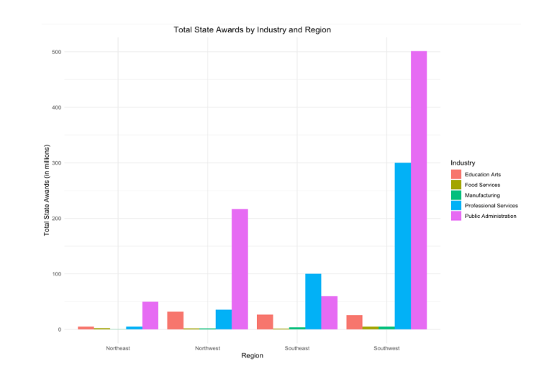
Total State Awards by Industry & Region

Slide 12
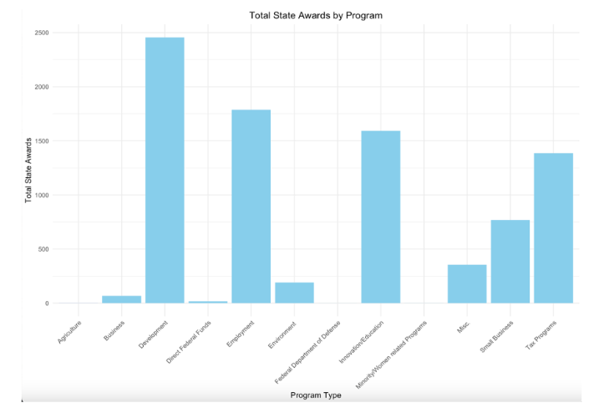
Total State Awards by Program

Slide 13

Using an alpha of 0.01, the entire model is statistically significant
38% of the variation in total states awards can be explained by knowing region, industry, program, and disbursements to date

Slide 14
Results: Region
Reference group: Northeast Region
Northwest region
Southeast Region
Southwest region
is associated with an increase of approximately $153,968 in the allocation of awards compared to the Northeast region
is associated with an estimated increase of $118,075 in the allocation of awards compared to the Northeast region
is associated with an estimated increase of $449,630 in the allocation of awards compared to the Northeast region

Slide 15
Results: Industry & Program
Program Reference Group: Agriculture
Industry Reference Group: Education Arts
Food service-Industry
Program
For every additional dollar spent in the food services sector, there is a decrease of $506,624 in the total state awards compared to the industry of education arts
Development related programs receive more funding compared to programs occupied significantly by women

Slide 16
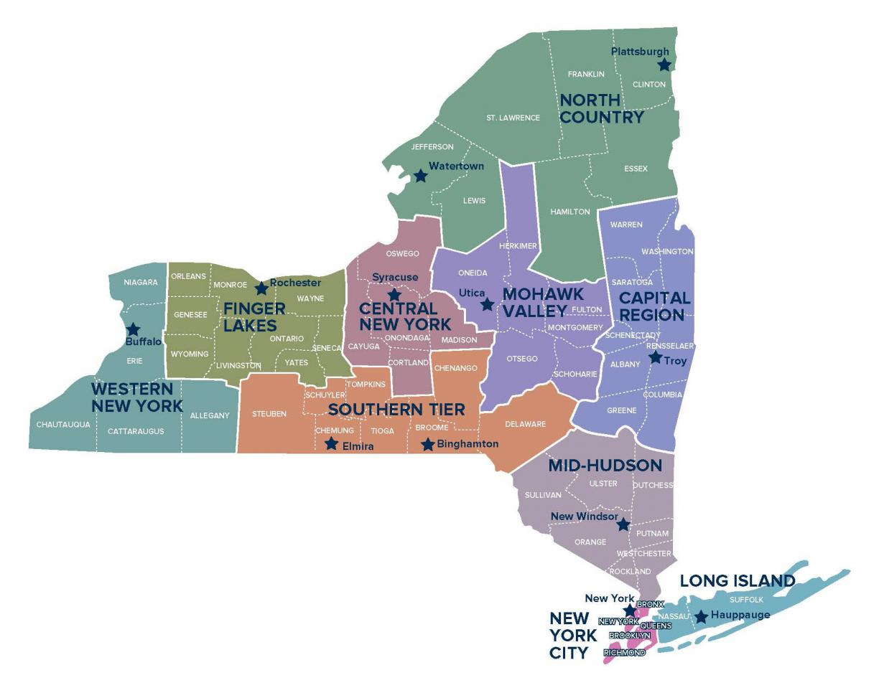
Minority Women
0.00637% of the total state awards was allocated to Minority/Women related programs
There is enough evidence to support these awards are below the threshold
Workforce
48.8% in the labor market in New York
Income
88.2 cents for every dollar earned by their male counterpart
Black Women
Earned only 67.8 cents for every dollar earned by men

Slide 17
Small Business
Number
8.9% of the total state awards was allocated to
small businesses
Not enough evidence to suggest that funding for small businesses is significantly low
2.3 million small businesses
Labor
Small businesses employ 4.1 million people
Active region
Most of the funds are allocated in the Southwest region of New York

Slide 18
Conclusion - Recommendations
Public awards are not evenly spread among industries, regions, and programs
Further analysis into the allocation strategies in New York to promote economic diversity
Measure the job creation impact of funded programs by race and sex, will help the state prioritize sectors that are not equally represented now

Slide 19


Thank you! Questions?
Data Noobs

Slide 20
Appendix
Dataset and Resources
Variables Description
Quantitative Summary Table
Categorical Summary Table
Regression Summary – Before & After Log Transformation
Regression Model Assumptions Before Outliers
Regression Model Assumptions After Outliers

Slide 21
Dataset and Resources
We used the “Database of Economic Incentives” from data.gov. It shows resources for businesses and programs seeking public and private funding. We focus on the funds the Department of State receives and allocates in different programs within New York State. We also looked at industry and occupation data from the Department of Labor within New York State.
Industry & Occupation Data: https://dol.ny.gov/occupational-and-industry-data
Lanza, A.J. (2023) NYC Small Business NYSenate.gov: https://www.nysenate.gov/newsroom/articles/2023/andrew-j-lanza/nyc-small-business
Small business first - nyc.gov: https://www.nyc.gov/assets/smallbizfirst/downloads/pdf/small-business-first-report.pdf
Dol, N. (2023) 2023 gender wage gap report: Impact of covid on women, NYS DOL Reports:https://nysdolreports.com/gwg/2023-gwgreport/
Original Dataset: https://catalog.data.gov/dataset/database-of-economic-incentives
Cleaned Data: (https://github.com/AGA-Datathon-2023/Data-Noobs/blob/main/NY%20Economic%20Incentives.csv)

Slide 22
Variables Description
Program
Agriculture
Federal Department of Defense
Region
Northeast
Business
Development
Direct Federal Funds
Employment
Environment
Innovation/Education
Minority/Women related Programs
Small Business
Tax Programs
Northwest
Southeast
Southwest
Public Administration programs
Industry
Education Arts
Food Services
Manufacturing
Professional Services
'Total State Awards' is the total Department of State assistance projects received
'Disbursements to Date' is the amount the projects have received up to date

Slide 23
Variables Description
Southwest
Capital District
Mid-Hudson
Southeast
Long Island
New York City
Northeast
North County
Northwest
Southern- Tier
Western New York

Slide 24
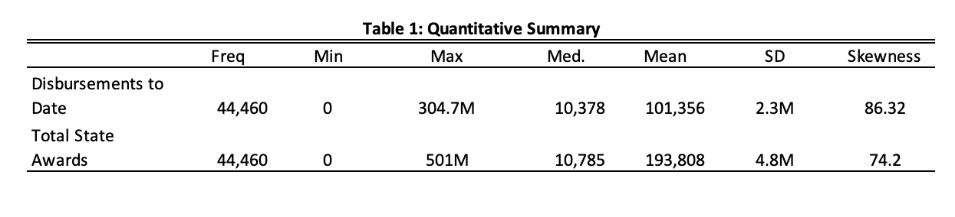
Quantitative Summary Table

Slide 25
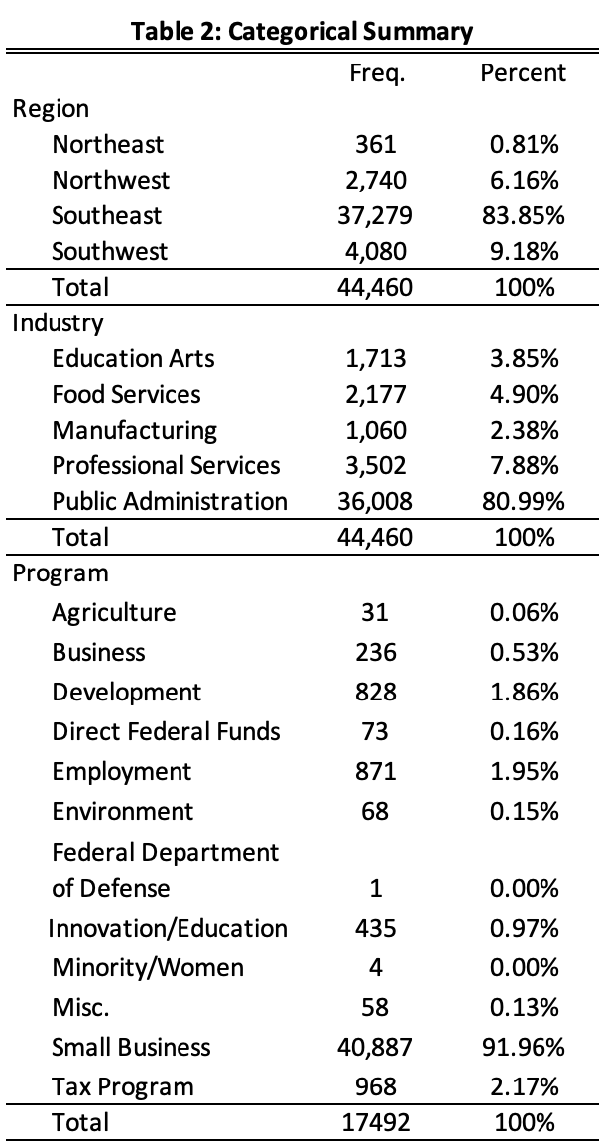
Categorical Summary Table

Slide 26
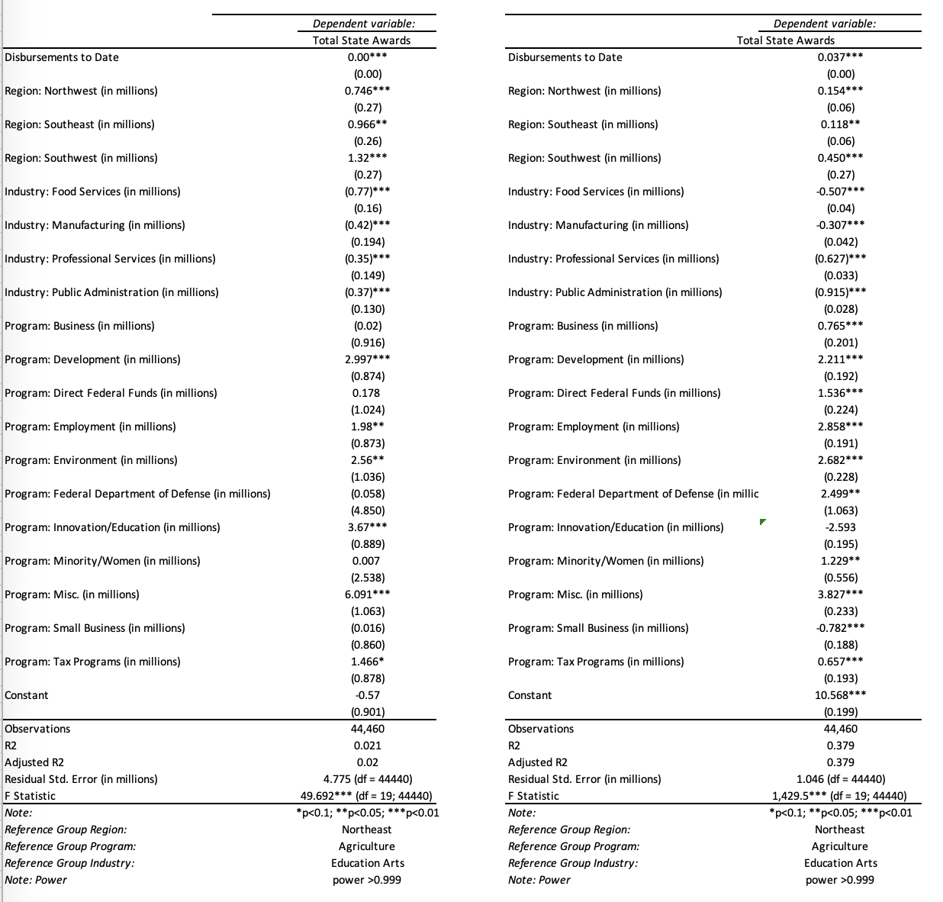
Regression Summary - Before & After Log Transformation

Slide 27
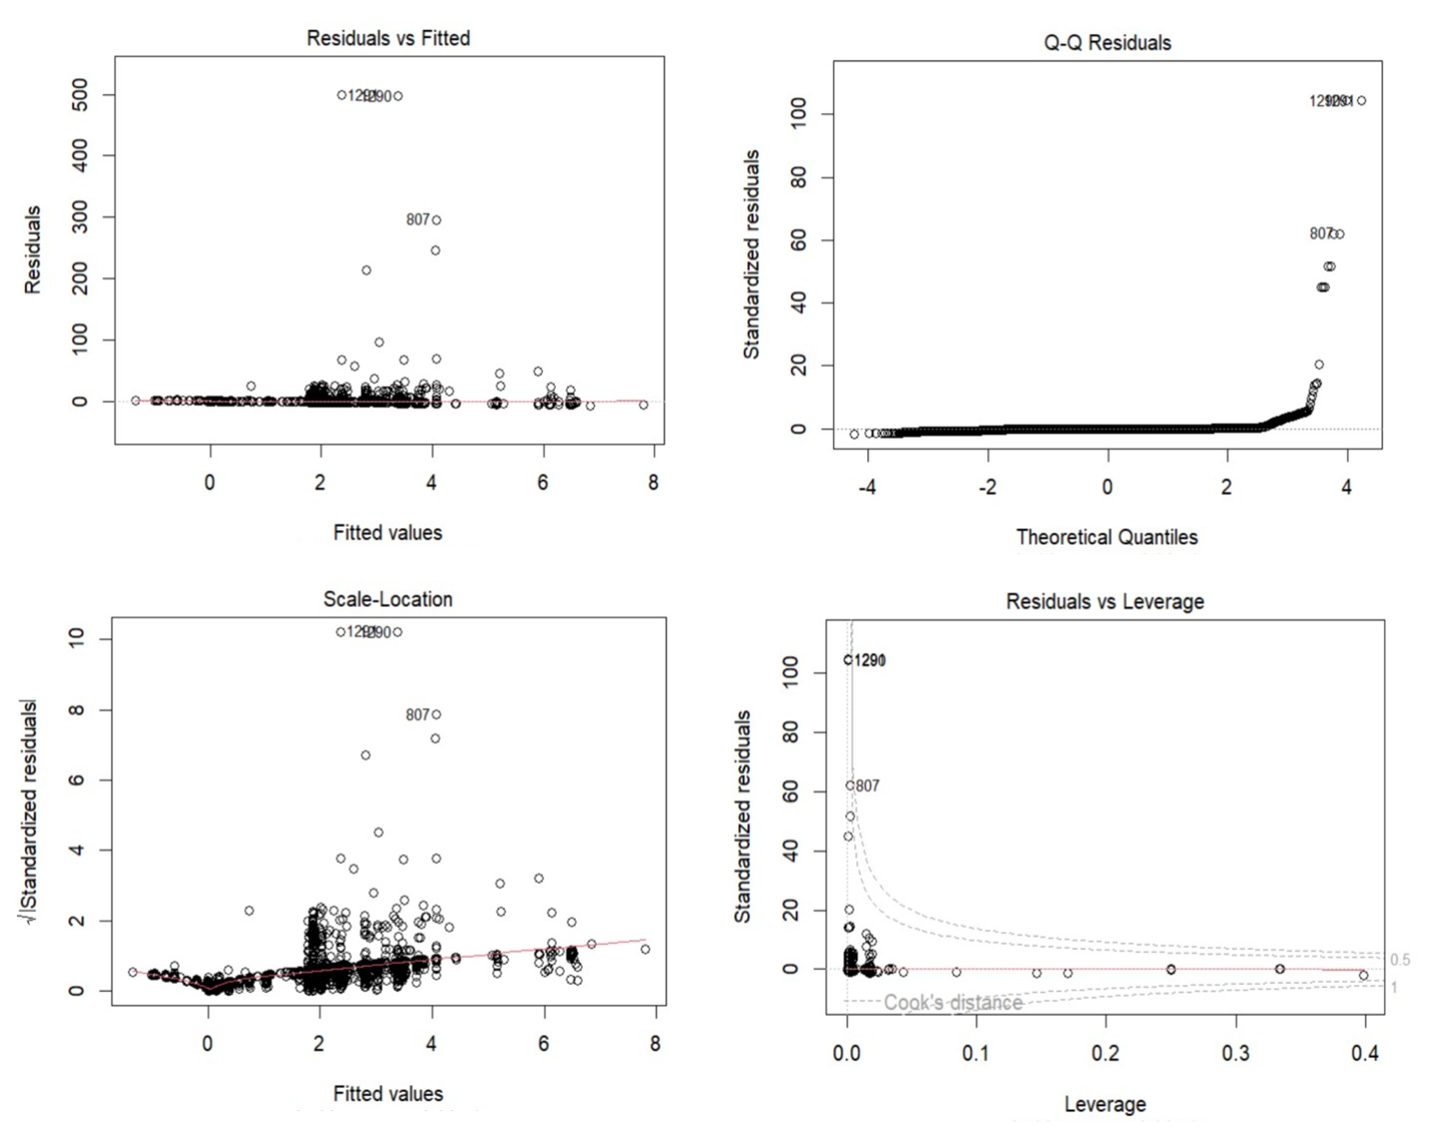
Regression Model Assumptions Before Outliers

Slide 28
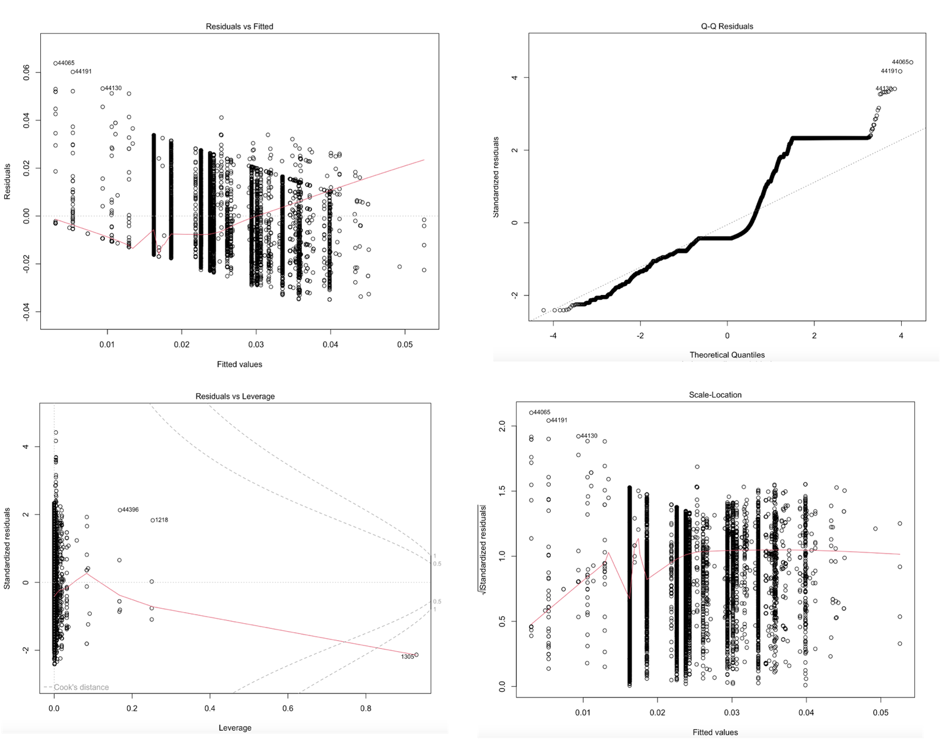
Regression Model Assumption After Outliers

